Slide 1
Chapter 8 Sequential logic design practices
SSI Latches and Flip-flops
Binary Counters
Shift registers

Slide 2
Chapter 8 Sequential logic design practices
SSI Latches and Flip-flops

Slide 3
74x74
74x375
P687 Fig 8-3
Pinouts
PR
D Q
CLK Q
CLR
1Q
1Q
2Q
2Q
3Q
3Q
4Q
4Q
1,2C
1D
2D
3,4C
3D
4D
74x109
PR
J Q
CLK
K Q
CLR
D Latches

Slide 4
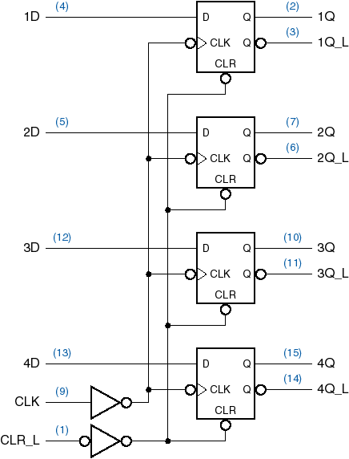
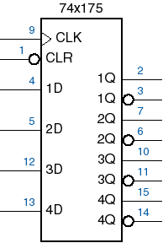
4-bit Flip-flop
74x175（异步清零）
1D
2D
3D
4D
CLK
CLR_L

Slide 5
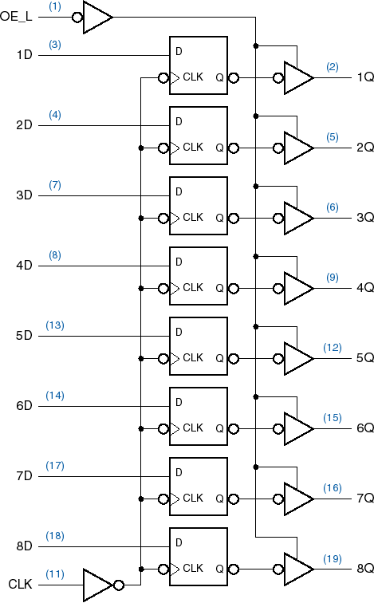
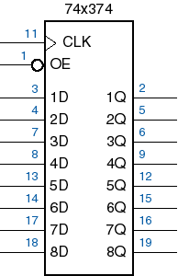
8-bit Register
输出使能
OE
74x374（三态输出）
P692图8-10

Slide 6
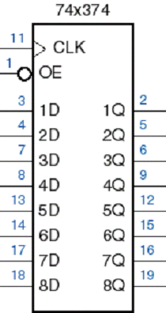
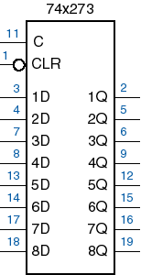
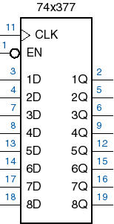
74x374
（输出使能）
74x273
（异步清零）
74x377
（置数使能）
CLK

Slide 7
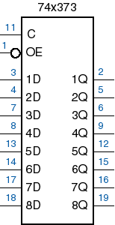
74x374
输出使能
8位触发器
74x373
输出使能
8位锁存器

Slide 8
Chapter 8 Sequential logic design practices
Binary Counters

Slide 9
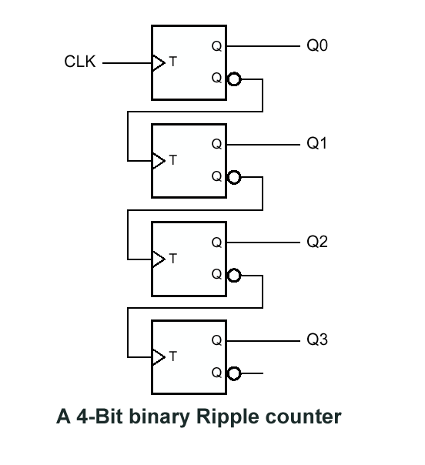
Ripple counter
Q3 Q2 Q1 Q0
0 0 0 0
0 0 0 1
0 0 1 0
0 0 1 1
0 1 0 0
0 1 0 1
0 1 1 0
0 1 1 1
1 0 0 0
LSB
When (i-1)_{th} bit changes
from 1→0，i_{th} bit toggles
MSB

Slide 10
Ripple counter
Q0
Q1
Q2
Q3
Q
Q
Q
Q
Q
Q
Q
Q
CLK
T
T
T
T
速度慢，
最坏情况，第n位要经过 n×t_{TQ} 的延迟时间
—— 异步时序

Slide 11
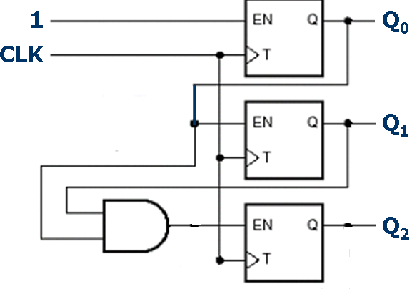
Synchronous counter
When the bits below the i_{th} bit are all 1, then the i_{th} bit changes its value
3 bit counter

Slide 12
Use D flip-flop to build：
D Q
CLK Q
D₀ = 1 ⊕ Q = Q’
D_{i} = (Q_{i-1} · … · Q₁ · Q₀) ⊕ Q

Slide 13
Question
How to construct a 2-bit counter in descending order
11→10→01→00→11…

Slide 14
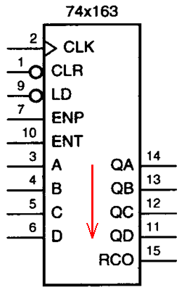
MSI Counters
CLR_L
LD_L
ENP ENT
OPERATION
0
1
1
1
1

0
1
1
1
 
 
0 
 0
1 1
0
load
Q
Q
Q+1
Input port
ENP: enable for state change
ENT: enable for state and RCO
Output port
Initial state:0000 final state:1111
RCO: final state =1

Slide 15
Clock
0
0
1
1
X
X
X
X
Clock
1
0
1
1
0
1
1
1
Clock
1
1
1
1
X
X
X
X
0
0
0
0
0
0
1
1
1
0
1
1
1
1
1

Slide 16

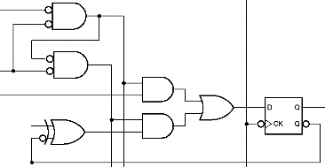
Synchronous Clear,Load and Enable
(同步清零、预置数和使能功能)
LD_L
CLR_L
A
QA
EN
P714 Fig 8-28

Slide 17
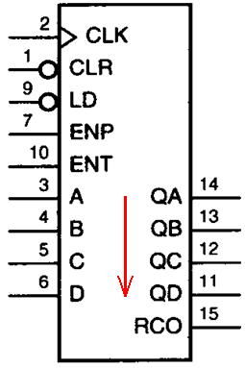
Other MSI Counters
74x161:mode 16 binary counter
with asynchronous CLR
Initial state:0000 Final state:1111
74x160:mode 10 counter with binary
code and asynchronous CLR
Initial state:0000 Final state:1001
74x162:mode 10 counter with binary
code and synchronous CLR
Initial state:0000 Final state:1001
Last state: RCO =1

Slide 18
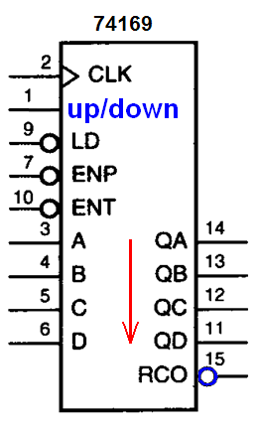
Other MSI Counters
LD_L
ENP_L ENT_L
UP/DOWN
OPERATION
0
1
1
1
1
 
1 
 1
0 0
0 0
X
X
X
1
0
Load
Q
Q
Q+1
Q-1
up/down=1:up
Initial state:0000
Last state:1111
up/down=0:down
Initial state:1111
Last state:0000
Last state: RCO=0 !
Ascending order
Descending order

Slide 19
Clock
0
0
0
0
1
1
0
0
Clock
0
1
0
0
X
X
X
X
Clock
1
1
0
0
X
X
X
X
1
1
0
0
1
0
0
0
0
0
1
1
1
1
0

Slide 20
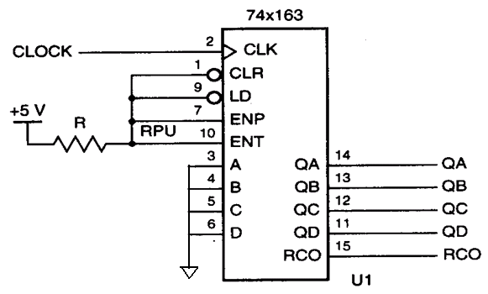
The applications of MSI counters
Mode/Modulus
16 counter
Initial state: 0000 Final state: 1111

Slide 21
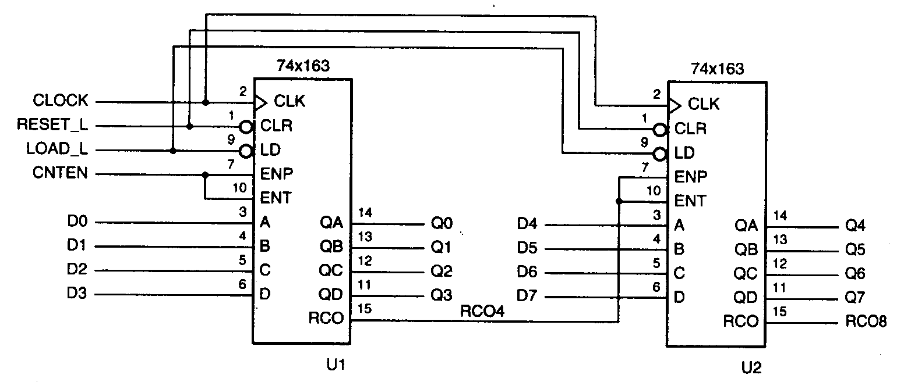
The applications of MSI counters
Mode-m counter: m>16
Cascading connection: Mode 256 counter !

Slide 22
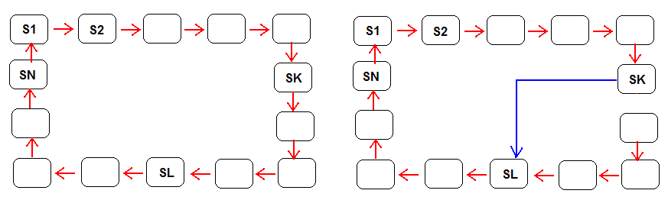
Mode change for counters
Mode SL-SK counter
Key point:
Detect SK Set SL

Slide 23
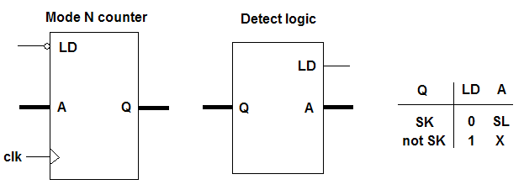
Mode change for counters

Slide 24
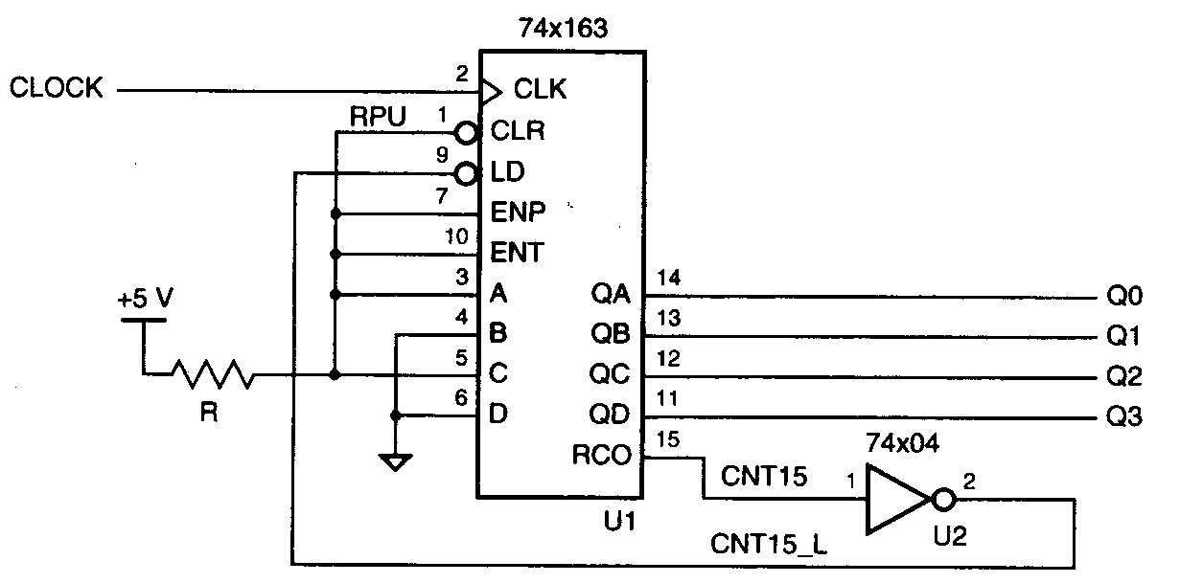
Mode change for counters
Mode-11: 5----15
Detect 1111 Set 0101

Slide 25
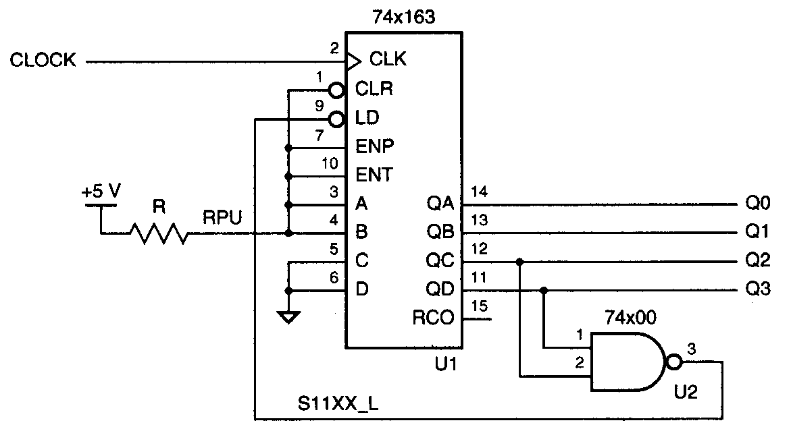
Mode change for counters
Mode 10 : 3---12 ( Excess-3 code )
Detect 1100 Set 0011

Slide 26
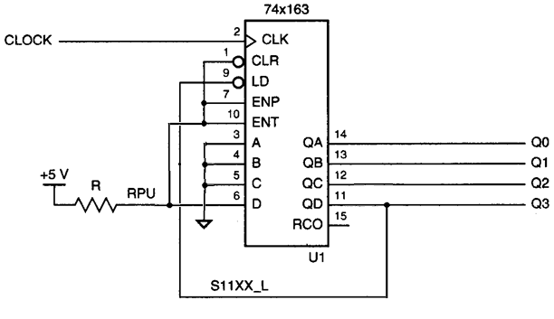
Mode change for counters
Mode 9 : 8---0
Detect 0000 Set 1000

Slide 27
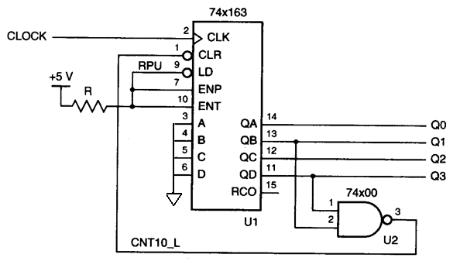
Mode change for counters
Mode 11 : 0---10
Detect 1010 Set 0000

Slide 28
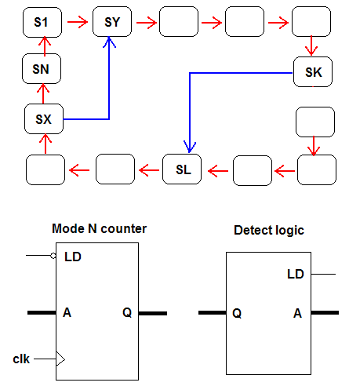
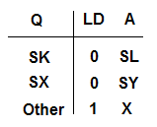
Mode change for counters

Slide 29
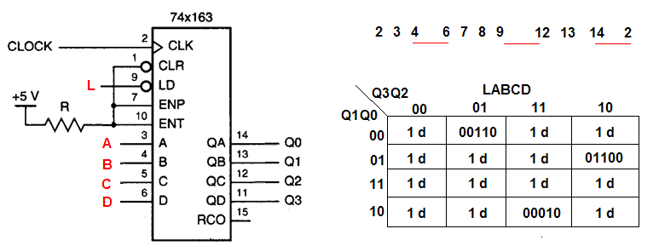
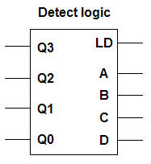




Mode change for counters
L/DCBA

Slide 30
Question
Design a mode 192 counter: 64-255?

Slide 31
Analyze what the mode of the following circuit is ?
74x163
CLOCK
CLK
CLR
LD
ENP
ENT
A QA
B QB
C QC
D QD
RCO
QD QC QB QA
0 0 0 0
0 1 1 0
0 1 1 1
1 0 0 0
1 1 1 0
1 1 1 1
+5V
0
1
1

Slide 32
Analysis what the mode of the following circuit is ?
74x163
CLOCK
CLK
CLR
LD
ENP
ENT
A QA
B QB
C QC
D QD
RCO
模12计数器
QD：12分频
占空比50％
+5V
0
1

Slide 33
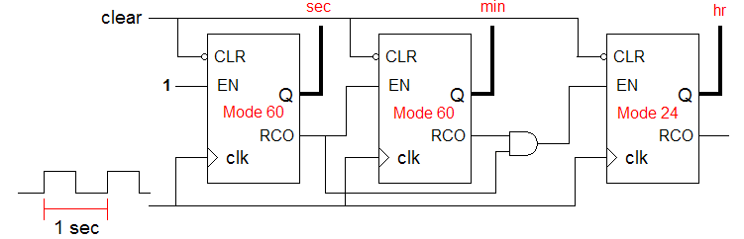
The applications of binary counters
Clock and watch

Slide 34
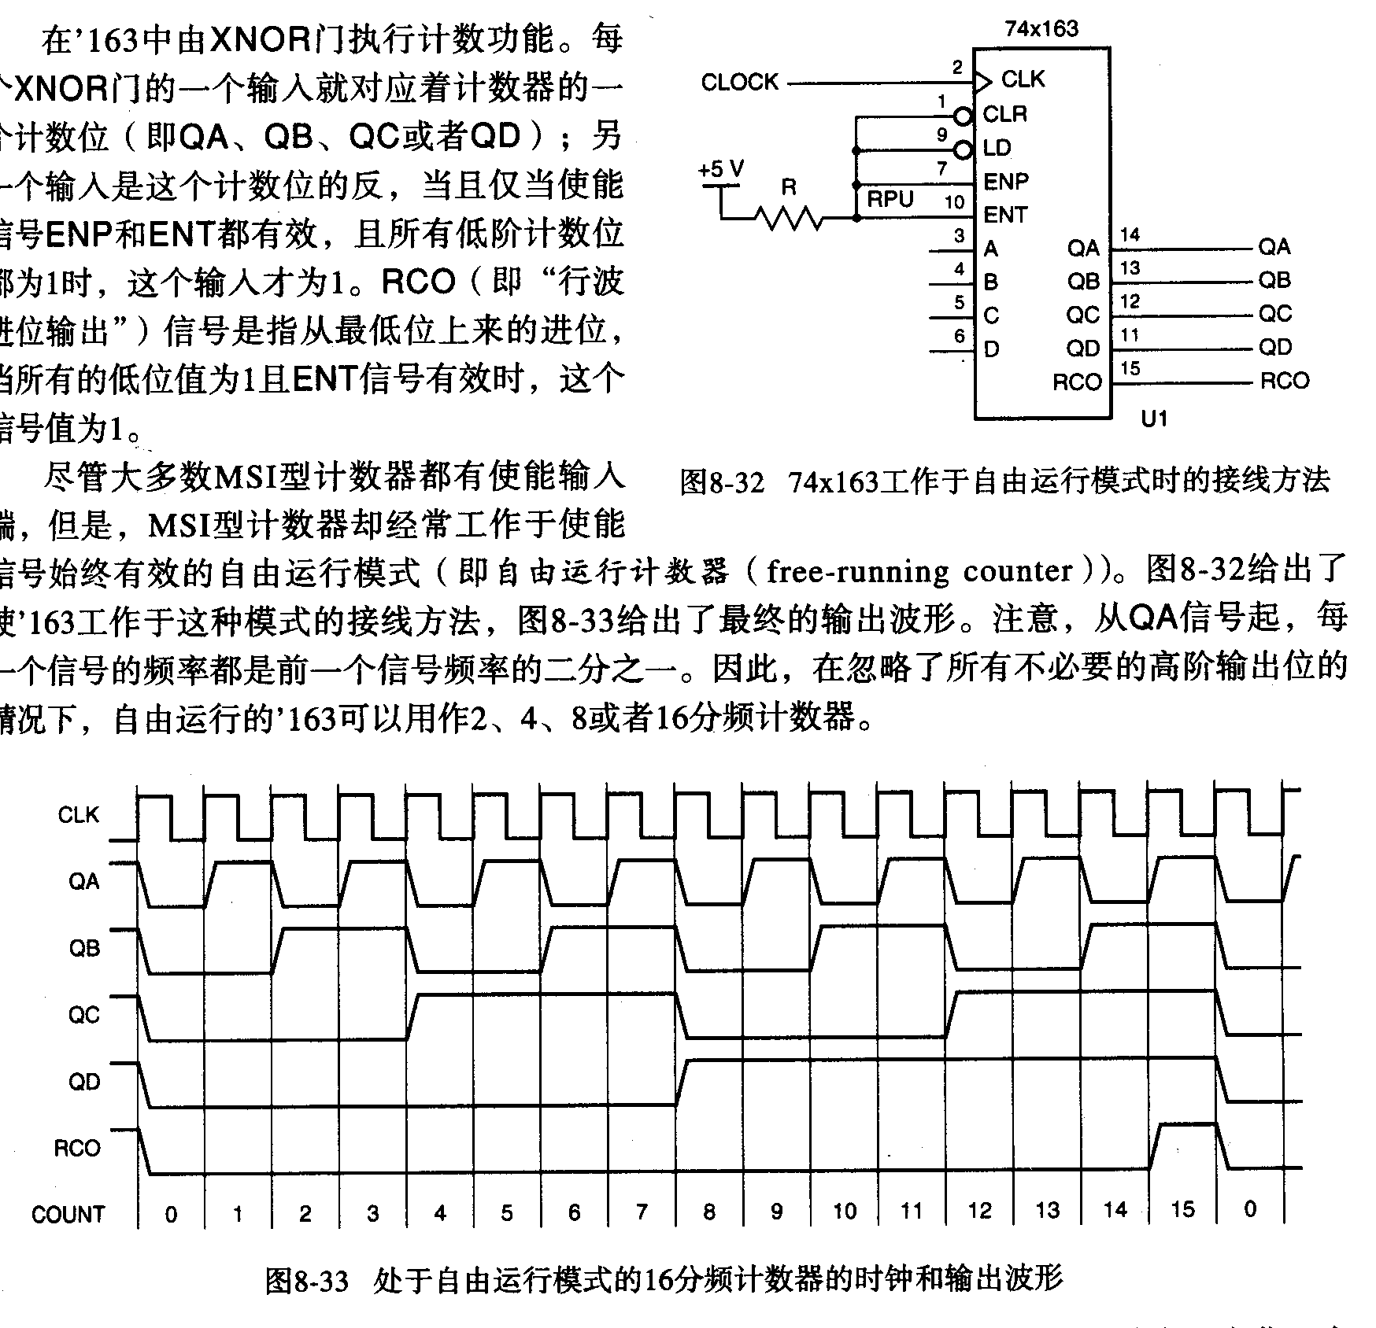
The applications of binary counters
Frequency divider
Frequency of CLK: f
QA: f/2 QB: f/4 QC: f/8 QD: f/16

Slide 35
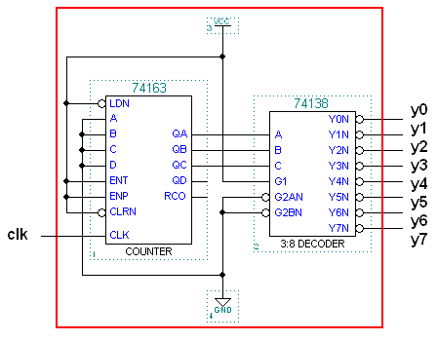
The applications of binary counters
Decoding of Binary-counter states

Slide 36
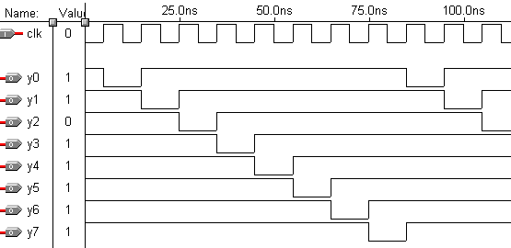
The applications of binary counters
A generator to get 1-out-of-m-coded signal
Output ‘0’ by order !

Slide 37
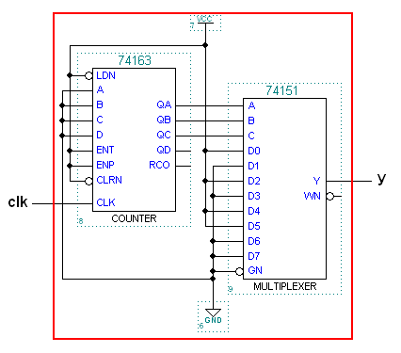
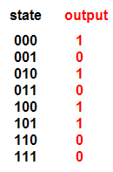
The applications of binary counters
Periodic sequence generator(10101100)

Slide 38
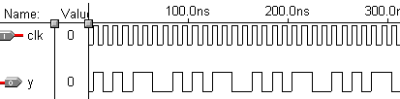
The applications of binary counters
Periodic sequence generator

Slide 39
Chapter 8 Sequential logic design practices
Shift register

Slide 40
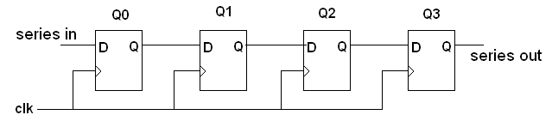
Shift register
Shifting the stored data to the next flip-flop
Applications: Delay line

Slide 41
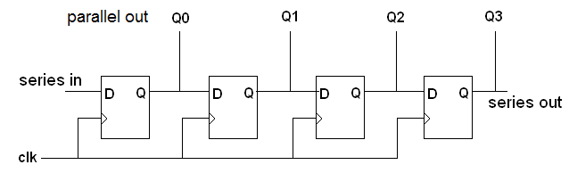
Shift register
Applications:
Sequential signal detector
Test chain in ASIC
S/P signal convertor

Slide 42
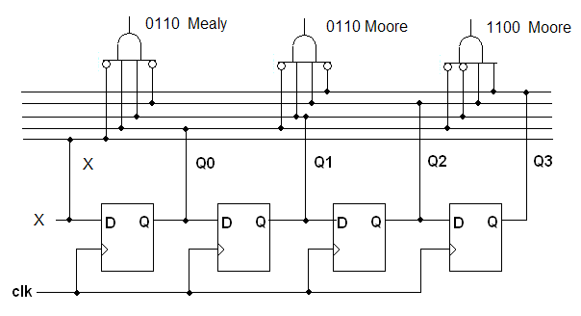
Sequential signal detector
Data may be reused (overlapping)

Slide 43
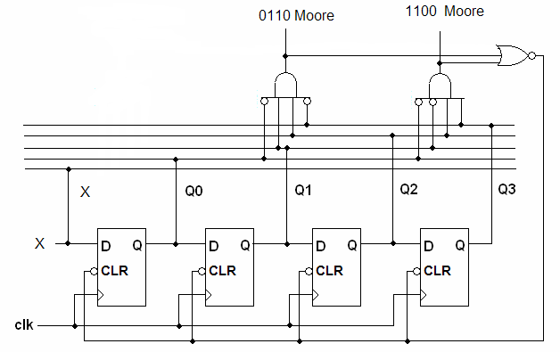
Sequential signal detector
Data can not be reused

Slide 44
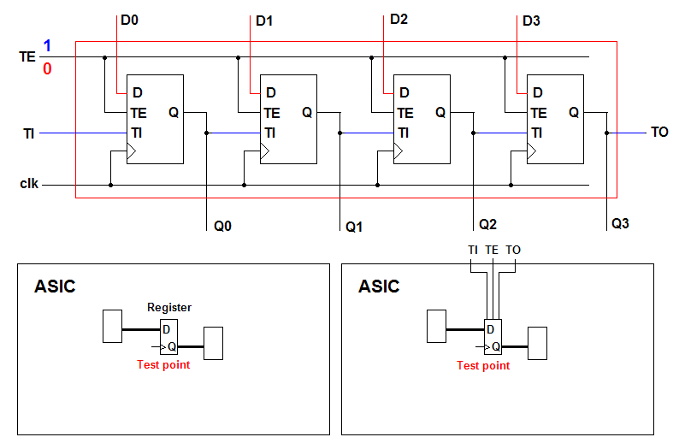
Test chain in ASIC

Slide 45
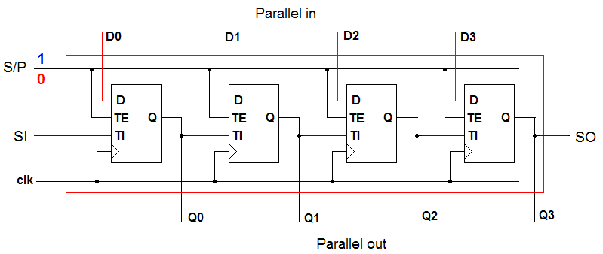
Series/parallel signal convertor

Slide 46
MSI shift register
74x164
74x166
CLK
CLR
SERA
SERB
CLK
CLKINH
SH/LD
CLR
SER
A
B
C
D
E
F
G
H QH
QA
QB
QC
QD
QE
QF
QG
QH
8 bit shift register
S in, P out;
A and B.
8 bit shift register
S/P in, S out;
With clk inhibit.

Slide 47
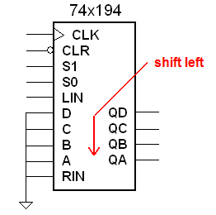
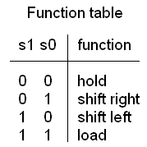
MSI shift register

Slide 48
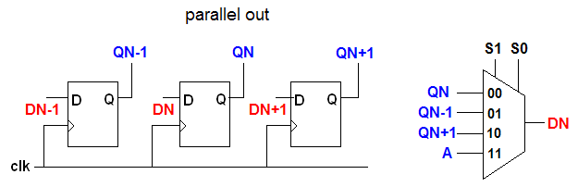
MSI shift register

Slide 49
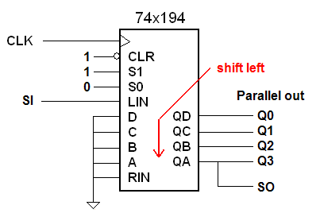
MSI shift register

Slide 50
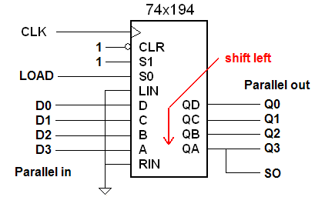
MSI shift register

Slide 51
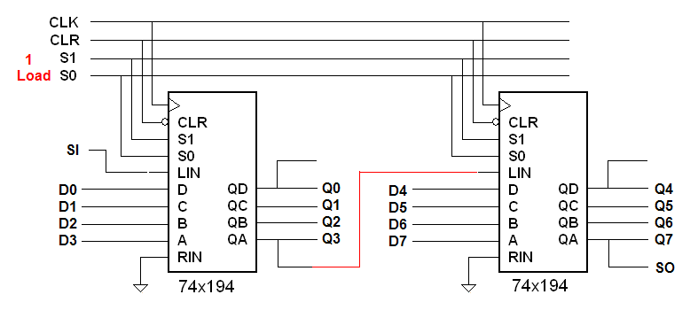
MSI shift register

Slide 52
Chapter 8 Sequential logic design practices
Shift register counter

Slide 53




Shift register counter
F
Feedback logic
Q3
Q2
Q1
Q0
Q D
CK
Q D
CK
Q D
CK
Q D
CK
Q
Q
Q
Q
CLK
Transition equation:

Slide 54
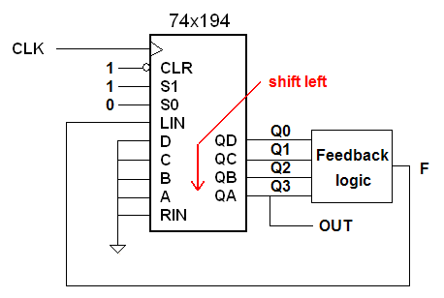
Shift register counter
F is a function of states

Slide 55
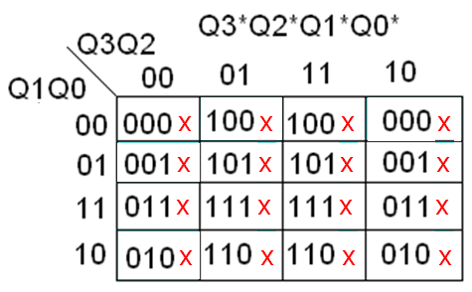
Shift register counter
Transition table:

Slide 56
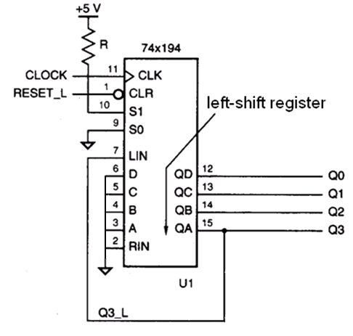
Shift register counter
Ring counter
Feedback logic:
F = Q3

Slide 57
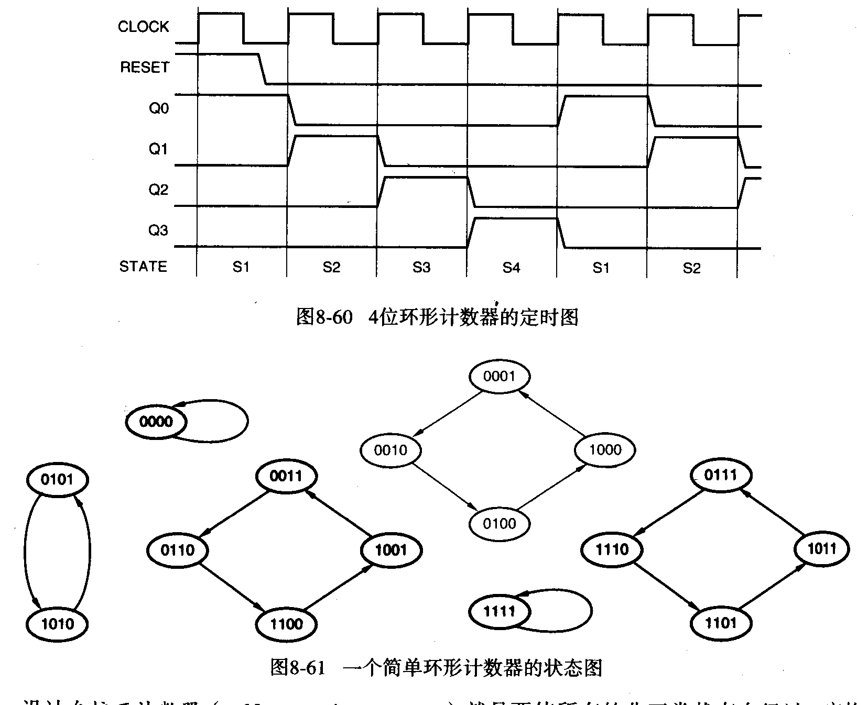
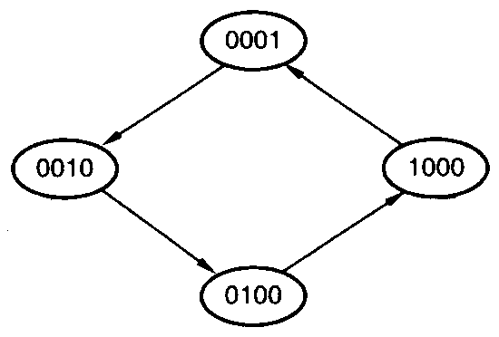
Shift register counter
Ring counter
One hot coding states

Slide 58

Shift register counter
Ring counter
N flip-flops: N states

Slide 59
Shift register counter
Many invalid state circles:
Not robust !

Slide 60




Shift register counter
Self-correcting or starting

Slide 61



Shift register counter
Feedback logic:
Johnson counter
N flip-flop: 2N states

Slide 62

Shift register counter
Johnson counter
At any trigger time, only one output change :
No glitches !
The duty cycle for any output port is 50%!

Slide 63


Shift register counter
Self-correcting
When Q3Q0=00
load 0001

Slide 64



Shift register counters
Linear feedback shift register (LFSR) counters

Slide 65
Shift register counters
LFSR: Maximum-length sequence generator
For given N, a sequence (1,c1,c2…) can be found to make a mode 2^{N}-1 counter . (Table 8-26)
N=2: (1,1) N=3: (1,1,0) n=4: (1,1,0,0)
N=5: (1,0,1,0,0) N=7: (1,0,0,1,0,0,0)
N=12: (1,1,0,0,1,0,1,0,0,0,0,0)
N=16: (1,0,0,1,1,1,0,0,0,0,0,0,0,0,0,0,0)

Slide 66



Shift register counter
LFSR counter example: 3 bits

Slide 67



Shift register counter
LFSR counters : modified to include “0” state

Slide 68


Shift register counter
Design for periodic sequence generator
001101
Output state analyze
001101 001
001101 011
001101 110
001101 101
001101 010
001101 100
Feedback logic:
Use 3 bits shift register

Slide 69
Shift register counter
Design for periodic sequence generator
001010
Output state analyze
001010 001
001010 010
001010 101
001010 010
001010 100
001010 000
001010 0010
001010 0101
001010 1010
001010 0100
001010 1000
001010 0001
Must use 4 bits shift register

Slide 70
Summary of Chap8
Counters
  Ripple counters, Synchronous counters
  Counter:74x163,74x169
  Application of Counter
    Arbitrary modulus-m counter
    Sequence generators
    Decoding binary counter states

Slide 71
Shift Registers
  Shift Register:74x194
  Application of shift register
    Shift register counters: Ring counters, Johnson counters, LFSR counters
    Sequence generator, sequence detector
    Serial-to-parallel conversion

Slide 72
Question
1、设计一个可变模同步计数器,当输入M=0时计数器按模6加法计数,M=1时计数器按模5加法计数
2、设计一个 110100 序列信号发生器
  利用状态机
  利用计数器集成芯片和组合电路集成芯片
  利用移位寄存器集成芯片

Slide 73
Homework
8.13
8.14
8.16 (将题目中的“0001”改为“00001”）
8.27
8.35 修改：记数顺序： 3,4,…,12,13,3,4
8.46
8.55
8.57
8.58

